Slide 1

RTL DESIGN AND VERIFICATION
Digital Security Locker using FSM
Simulated and verified on EDA Playground
P. Prithika | 312424106128
Sherley Ketziah | 312424106162
Ranjana Devi | 312424106131
Yoga | 312424106188
SD0212 RTL Design and Verification
St. Joseph’s Institute of Technology, Chennai
Notes:
Introduce the project title, the team and the course. The project is an RTL design of a digital security locker modelled as a finite state machine.

Slide 2



Project Overview
Objective
Why an FSM
Scope
Open the locker only for the correct 4-bit password and sound an alarm after repeated wrong attempts.
Behaviour depends on earlier attempts, so a state machine models the locker cleanly.
Verilog RTL, a self-checking testbench and waveform verification on EDA Playground.
Notes:
Three points: what we built, why a state machine is the right model, and what the scope of the work was.

Slide 3
Inputs and Outputs
INPUTS
OUTPUTS
clk
unlock
rst
digital_security_locker
4-state FSM
PASSWORD = 4’b1010
buzzer
submit
attempt_count [1:0]
user_password [3:0]
Notes:
The module takes a clock, an asynchronous reset, a submit pulse and a 4-bit password. It gives unlock, buzzer and a 2-bit wrong-attempt counter. The stored password is a parameter, set to 1010.

Slide 4
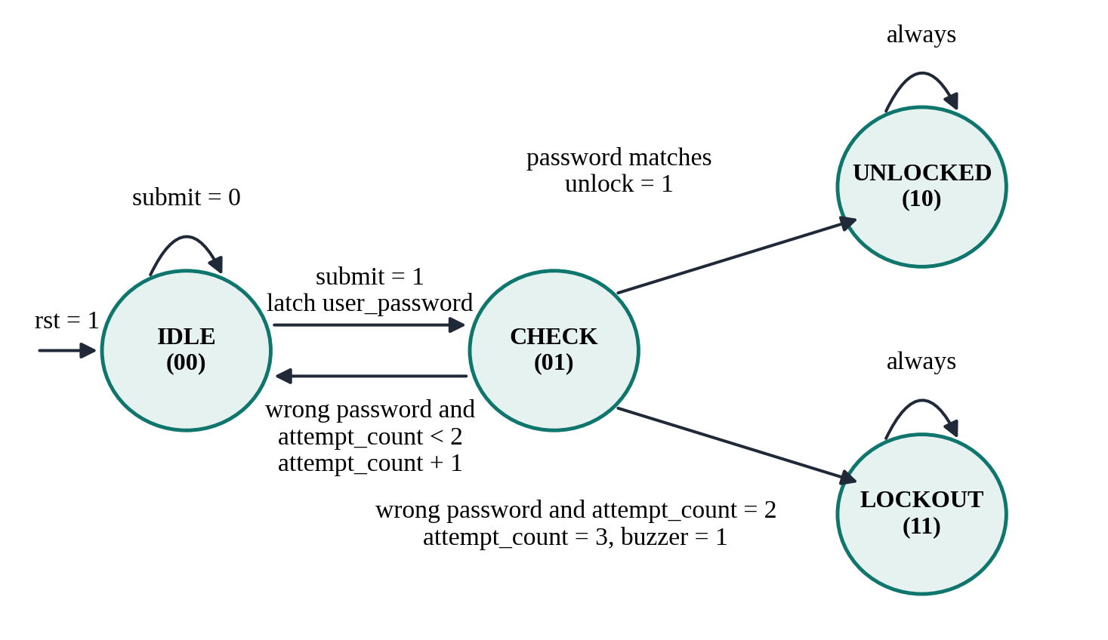
FSM State Diagram
IDLE 00
Waits for submit and latches the password
CHECK 01
Compares with the stored password
UNLOCKED 10
Correct code: unlock = 1
LOCKOUT 11
Three wrong tries: buzzer = 1
UNLOCKED and LOCKOUT hold until reset.
Notes:
Walk through the diagram: IDLE to CHECK on submit; CHECK goes back to IDLE on a wrong password, to UNLOCKED on a match, or to LOCKOUT on the third wrong attempt. Both end states hold until reset.

Slide 5
Hardware Architecture
user_password
4 bits
Password register
4 flip-flops
Comparator
== 1010
FSM controller
state + logic
unlock | buzzer | attempt_count
10
4-bit
2-bit
D flip-flops in total
equality comparator
wrong-attempt counter
Notes:
The design is small: ten flip-flops for the state, the latched password, the attempt counter and the two outputs, plus a 4-bit comparator and a 2-bit counter.

Slide 6
Verification Plan
Test | Password | Expected result
Reset | rst = 1 | All outputs low
Test 1 | 0011 (wrong) | attempt_count = 1
Test 2 | 0101 (wrong) | attempt_count = 2
Test 3 | 1100 (wrong) | Buzzer ON, count = 3
Test 4 | 1010 (correct) | Stays locked
Self-checking testbench
100 MHz clock
Reusable password task
VCD dump for EPWave
Automatic PASS / FAIL
Notes:
Test 4 is the key security check: the correct password is entered after lockout and must be rejected. The testbench checks attempt_count, buzzer and unlock automatically.

Slide 7
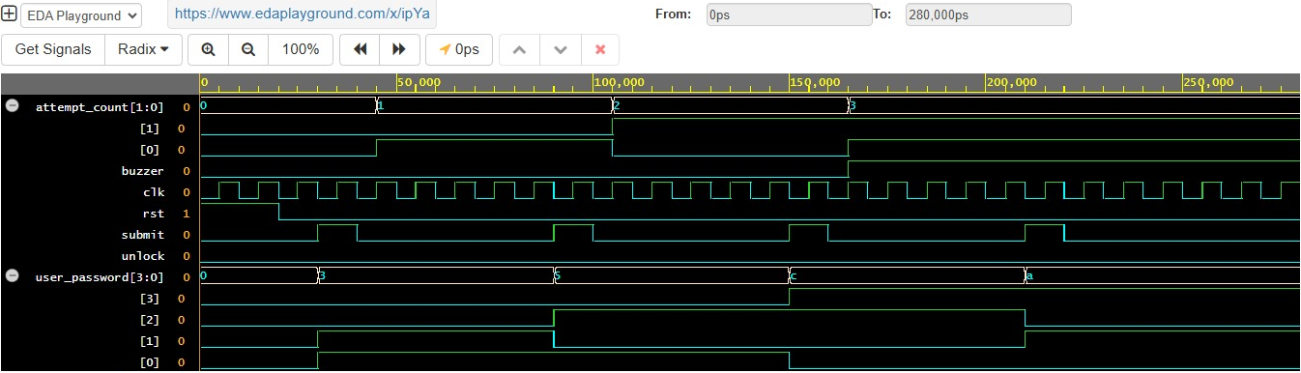
Simulation Results
0 to 3
165 ns
unlock = 0
attempt_count after three wrong tries
buzzer turns ON at lockout
correct code rejected after lockout
Notes:
Point to the waveform: attempt_count steps 0, 1, 2, 3 after each wrong password; the buzzer rises with the third; unlock stays low even when 1010 is applied at 210 ns. The console printed PASS.

Slide 8
Conclusion and Future Scope
CONCLUSION
FUTURE SCOPE
Locker designed as a 4-state FSM in Verilog
Opens only for the correct password
Alarm and permanent lockout after 3 wrong attempts
Verified by a self-checking testbench: PASS
Test the unlock path and random inputs
Keypad debouncing and longer passwords
Synthesis to GDSII and FPGA prototype
Thank you
Notes:
Summarise: the locker works as specified at RTL level. The main follow-up is to add the unlock-path test and move on to synthesis and physical design. Invite questions.

